Slide 1

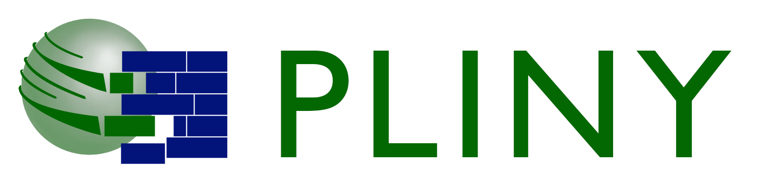
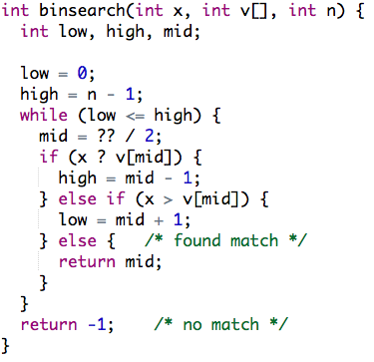
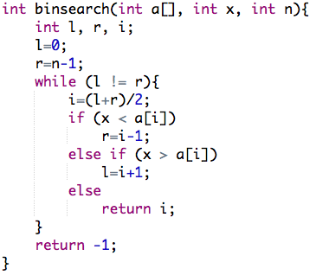
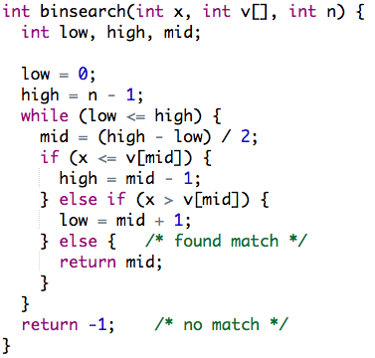
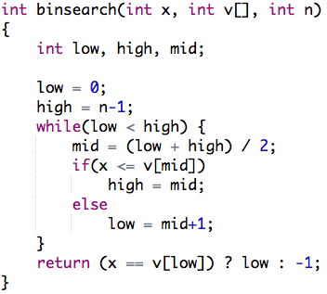

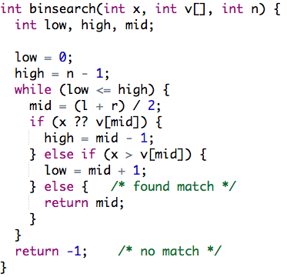
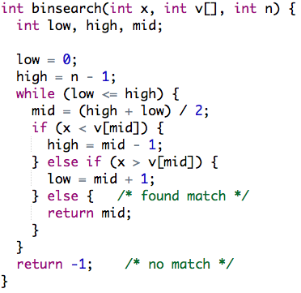
Corpus-driven Program Repair
Yanxin Lu, Swarat Chaudhuri, Christopher Jermaine,
Vijayaraghavan Murali
Department of Computer Science, Rice University
Introduction
Pipeline
Query the DB
Filling in the Holes
Automatically repair an incorrect algorithmic program
Using a large corpus
Leidos
Modules
Search for similar programs in the DB
Top-k similar programs
A set of features
10 similar programs for binary search
Search for ways to replace holes
Preprocessing source from the Leidos corpus
A set of individual buildable projects
50 GB of source code
Coupling Feature:
('int', 'c:unary-’)
('int', 'c:/’)
('int*', 'c:+’)
('int', 'c:+’)
('int', 'c:-’)
('int', 'c:==’)
Feature Extraction
Elements capturing difference characteristics of programs
Light-weight analysis
Store programs with features into the DB
Skeleton Feature:
(seq (loop (seq (cond ()))))
Variable Renaming
PDB
Templates
Variables from good programs might not be defined in the templates.
Less than 60 candidate programs
Objective
Incorrect Program
Replacing differences with holes
Ignore variable names
A code database D
An incorrect program P
Use the programs in D and P to generate a new program P’
P’ is correct
P’ is as syntactically similar to P as possible
Similar Programs
Template Generation
Correct Fix
Program Repair
Filtering out incorrect fixes using unit testing
Unit Testing
Correct Fix
Less than 1 minute

