Slide 2
Improving Peer Evaluation Quality in MOOCs
Yanxin Lu
December 2014

Slide 3
Summary
Motivations and Problems
Experiment
Statistical Analysis
Results
Conclusion

Slide 4
Summary
Motivations and Problems
Experiment
Statistical Analysis
Results
Conclusion

Slide 5
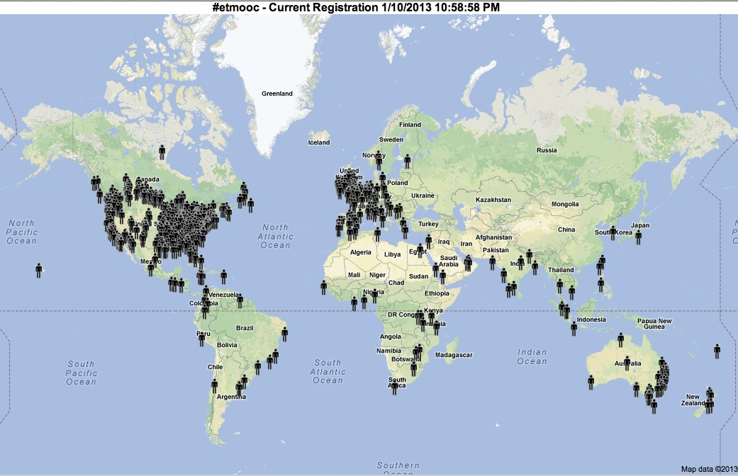
What is MOOC?
http://teacher4online.files.wordpress.com/2013/01/participants-in-etmooc.jpg

Slide 6

Intro to Interactive Programming in Python
120,000 enrolled and 7,500 completed the course
https://www.coursera.org/course/interactivepython

Slide 7
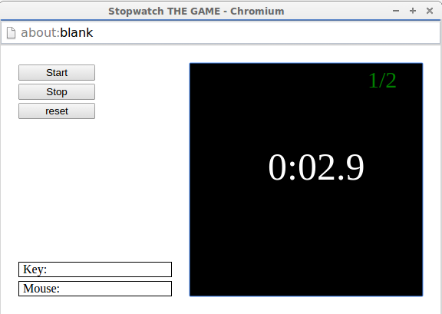
Stopwatch

Slide 8
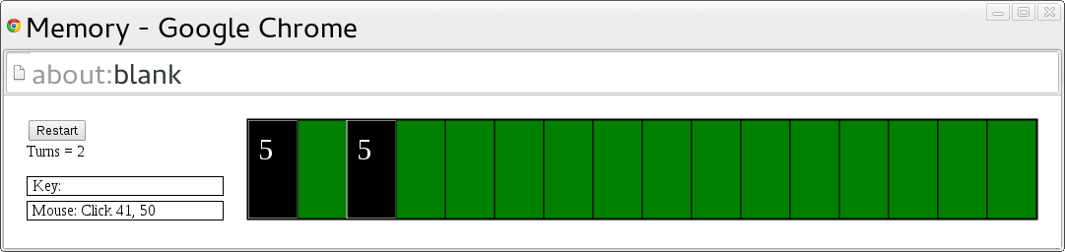
Memory
http://2.bp.blogspot.com/-I6RlqEzxbM4/UriqzFrughI/AAAAAAAACEM/bXeBfE4NRXE/s1600/python_memory_game.png

Slide 9
Grading Rubric for Stopwatch
1 pt - The program successfully opens a frame with the stopwatch stopped.
2 pts - The program correctly draws the number of successful stops at a whole second versus the total number of stops. Give one point for each number displayed. If the score is correctly reported as a percentage instead, give only one point.

Slide 10

Peer Grading
9
9
9
1
10
Score = 9

Slide 11
Quality is Highly Variable
Lack of effort
Small bugs require more effort

Slide 12
Solution
A web application where students can
  Look at other peer evaluations
  Grade other peer evaluations
Notes:
When students knows that their own peer grading efforts are being examined and they can evaluate other peer grading efforts, do these tend to motivate the students to do a better job when grading assignments?

Slide 13
Findings
Grading evaluation has the strongest effect
The knowledge that one’s own peer evaluation will be examined does not
We found a strong effect on peer evaluation quality simply because students know that they are going to be studied using a software that is supposed to help with peer grading.

Slide 14
Summary
Motivations and Problems
Experiment
Statistical Analysis
Results
Conclusion

Slide 15
Experiment Summary
Sign up
Stopwatch
Memory

Slide 16
Sign up
Before Stopwatch
Web consent form
  Three groups
  Prize
  Nothing about specific study goals
  Nothing about what was being measured
3,015 students

Slide 17
Three Groups
Three groups (randomly partitioned)
  G1 : Full treatment, grading + viewing
  G2 : Only viewing
  G3 : Control group
Size
  G1 : G2 : G3 = 8 : 1 : 1
  Make sure we have enough graded evaluations

Slide 18
Experiment
Stopwatch
  Fourth week
Memory
  Sixth week
Submission Phase
Evaluation Phase
Grading Evaluation Phase
Viewing Phase

Slide 19
Experiment
G1, G2 ,G3
Submit programs before the deadline
Submit through a special link
Submission Phase
Evaluation Phase
Grading Evaluation Phase
Viewing Phase

Slide 20
Experiment
Evaluate multiple submissions
  1 self evaluation
  5 peer evaluations
Per rubric item
  Score
  Optional comment
Students see the score of their programs
Submission Phase
G1, G2 ,G3
Evaluation Phase
Grading Evaluation Phase
Viewing Phase

Slide 21
Experiment
A web application
Per evaluation × rubric item
  Good
  Neutral
  Bad
Multiple Submissions
  Multiple evaluations per submission
Submission Phase
Evaluation Phase
G1
Grading Evaluation Phase
Viewing Phase

Slide 22
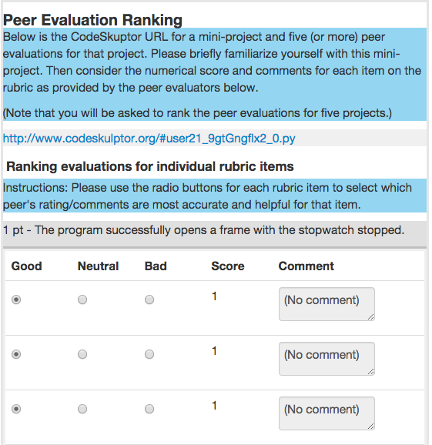
Experiment
A web application
Per evaluation × rubric item
  Good
  Neutral
  Bad
Multiple Submissions
Submission Phase
Evaluation Phase
G1
Grading Evaluation Phase
Viewing Phase

Slide 23
Experiment
Per evaluation × rubric item
  Number of good
  Number of neutral
  Number of bad
Their own evaluation
Submission Phase
Evaluation Phase
Grading Evaluation Phase
G1, G2
Viewing Phase

Slide 24
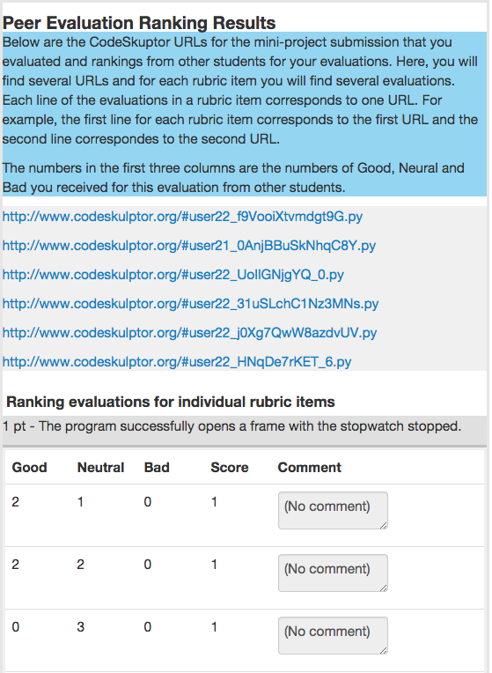
Experiment
Submission Phase
Evaluation Phase
Grading Evaluation Phase
G1, G2
Viewing Phase

Slide 25
Statistics
 | Sign up | Stopwatch | Memory
G1 | 2,412 | 1,891 | 1,387
G2 | 301 | 244 | 192
G3 | 302 | 231 | 167
Total | 3,015 | 2,366 | 1,746
Submissions |  | 2979 | 2036
Graded Evaluations |  | > 8000 | > 5830
Most evaluations are graded three times

Slide 26
Summary
Motivations and Problems
Experiment
Statistical Analysis
Results
Conclusion

Slide 27
Goal
Whether G1 does a better job grading compared to G2, G3 or both
Measuring the quality of students’ grading efforts
  Whether an evaluator grades correctly (score)
  How much time and effort taken in writing comments (comment length)
Reject a set of null hypotheses

Slide 28
Bootstrapping
A simulation-based method
  Use resampling with replacement to simulate a very large number of data sets from collected data set for many times
  Check null hypothesis on each simulation
  P-value = percentage of times null hypothesis holds
  Statistically significant: p-value <= 0.05

Slide 29
Summary
Motivations and Problems
Experiment
Statistical Analysis
Results
Conclusion

Slide 30
Terms
Good programs: Correct programs tested by our assignment-specific machine grader
Bad programs: Incorrect programs tested by our assignment-specific machine grader
Bad job: assigning incorrect grade or writing no comment
Really bad job: assigning incorrect grade and writing no comment

Slide 31
Results
H0 = “The mean comment length for group A is no greater than the mean comment length for group B on good programs”
 |  | Stopwatch |  |  | Memory
Group A | Group B | Group A Mean | Group B Mean | P-value | Group A Mean | Group B Mean | P-value
G1 | G2 | 79.05 | 69.54 | 0.0085 | 77.92 | 61.48 | 0.0001
G1 | G3 | 79.05 | 71.92 | 0.0456 | 77.92 | 64.26 | 0.0012
G2 | G3 | 69.54 | 71.92 | 0.6714 | 61.48 | 64.26 | 0.6805

Slide 32
Results
H0 = “The mean comment length for group A is no greater than the mean comment length for group B on bad programs”
 |  | Stopwatch |  |  | Memory
Group A | Group B | Group A Mean | Group B Mean | P-value | Group A Mean | Group B Mean | P-value
G1 | G2 | 177.30 | 167.65 | 0.1273 | 161.12 | 151.75 | 0.2234
G1 | G3 | 177.30 | 164.92 | 0.0972 | 161.12 | 137.87 | 0.0381
G2 | G3 | 167.65 | 164.92 | 0.4071 | 151.75 | 137.87 | 0.2077

Slide 33
Results
H0 = “The fraction of people doing a ‘bad job’ in group A is no less than the fraction doing a ‘bad job’ in group B”
 |  | Stopwatch |  |  | Memory
Group A | Group B | Group A Mean | Group B Mean | P-value | Group A Mean | Group B Mean | P-value
G1 | G2 | 0.3820 | 0.4007 | 0.0351 | 0.3477 | 0.4021 | 0
G1 | G3 | 0.3820 | 0.4091 | 0.0054 | 0.3477 | 0.4157 | 0
G2 | G3 | 0.4007 | 0.4091 | 0.2729 | 0.4021 | 0.4157 | 0.2341

Slide 34
Results
H0 = “The fraction of people doing a ‘really bad job’ in group A is no less than the fraction doing a ‘really bad job’ in group B”
 |  | Stopwatch |  |  | Memory
Group A | Group B | Group A Mean | Group B Mean | P-value | Group A Mean | Group B Mean | P-value
G1 | G2 | 0.04522 | 0.05051 | 0.1218 | 0.03404 | 0.04442 | 0.0343
G1 | G3 | 0.04522 | 0.06133 | 0.0009 | 0.03404 | 0.04648 | 0.0255
G2 | G3 | 0.05051 | 0.06133 | 0.0508 | 0.04442 | 0.04648 | 0.3893

Slide 35
Results
H0 = “The mean comment length for group A is no greater than the mean score for group B on good programs”
 |  | Stopwatch |  |  | Memory
Group A | Group B | Group A Mean | Group B Mean | P-value | Group A Mean | Group B Mean | P-value
G1 | G2, G3 | 79.05 | 70.71 | 0.0037 | 77.92 | 62.73 | 0

Slide 36
Results
H0 = “The mean comment length for group A is no greater than the mean score for group B on bad programs”
 |  | Stopwatch |  |  | Memory
Group A | Group B | Group A Mean | Group B Mean | P-value | Group A Mean | Group B Mean | P-value
G1 | G2, G3 | 177.30 | 166.34 | 0.0421 | 161.12 | 144.91 | 0.0435

Slide 37
Results
H0 = “The fraction of people doing ‘bad job’ in group A is no less than the fraction doing ‘bad job’ in group B”
 |  | Stopwatch |  |  | Memory
Group A | Group B | Group A Mean | Group B Mean | P-value | Group A Mean | Group B Mean | P-value
G1 | G2, G3 | 0.3820 | 0.4048 | 0.0011 | 0.3477 | 0.4083 | 0

Slide 38
Results
H0 = “The fraction of people doing ‘really bad job’ in group A is no less than the fraction doing ‘really bad job’ in group B”
 |  | Stopwatch |  |  | Memory
Group A | Group B | Group A Mean | Group B Mean | P-value | Group A Mean | Group B Mean | P-value
G1 | G2, G3 | 0.04522 | 0.05577 | 0.0025 | 0.03404 | 0.04537 | 0.0043

Slide 39
Findings
Grading evaluation has the strongest positive effect
The knowledge that one’s own peer evaluation will be examined does not
We found a strong effect on peer evaluation quality simply because students know that they are going to be studied using a software that is supposed to help with peer grading.

Slide 40
Conclusion
A web application
Study has positive effect on the quality of peer evaluations
Beyond peer evaluations

