Slide 1

Data-Driven Program Repair
Yanxin Lu, Swarat Chaudhuri, Christopher Jermaine, Joe Warren and Scott Rixner

Slide 2
Debugging is difficult
https://docs.google.com/spreadsheet/ccc?key=0Aqe2P9sYhZ2ndElxbjVTcnV2bHFOWmUwSkt2bjZLdVE&usp=drive_web#gid=5
Notes:
Programming is hard, but debugging is even more difficult. Can we solve this problem automatically?

Slide 3
Related work
Talus, tutoring system (Murray, 1986)
  Reference program
  Program analysis
Mutation (Debroy and Wong, 2010)
  A set of predefined rules for mutating the program
Notes:
Related work includes Talus, reference program + mutation.

Slide 4
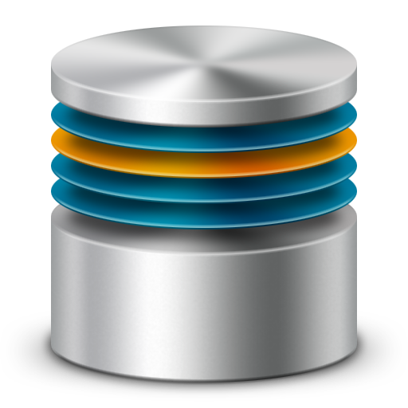
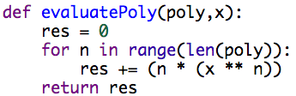
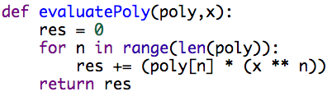
Data-driven program repair
Code database for evaluatePoly
Incorrect Program
Correct Program

Slide 5
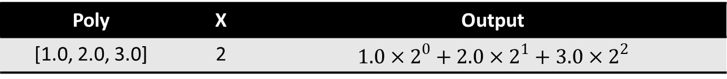
EvaluatePoly
A program which evaluates polynomials
  Poly : A list of coefficients
  X : the x value in the polynomial
Poly | X | Output
[1.0, 2.0, 3.0] | 2 | $$1.0×2^{0}+2.0×2^{1}+3.0×2^{2}$$
Incorrect Program
Correct Program

Slide 6
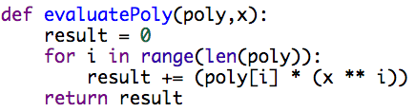
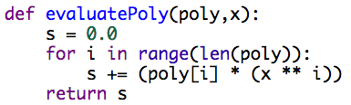
Similar and correct implementations
Distance between programs
Incorrect Program
Code Database
Correct Programs
Template Generation

Slide 7
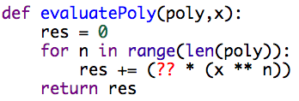
Template Generation
Find differences and replace them with holes
  Ignore variable names
Incorrect Program
Correct Program
Template

Slide 8
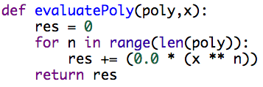
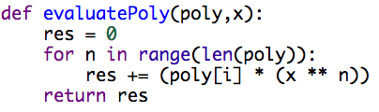
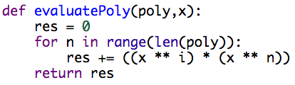
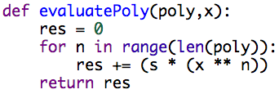
Filling in the Holes
Search for ways to replace holes
Template
Correct Program
Variable Renaming

Slide 9
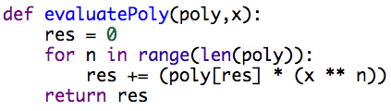
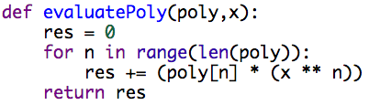
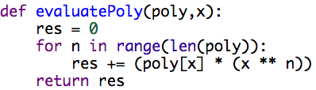
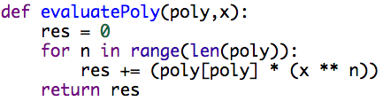
Variable Renaming
Rename the variables in the good program

Slide 10
Unit Testing
Filter all incorrect fixes using unit testing
If there are multiple correct fixes
Choose the most similar one

Slide 11
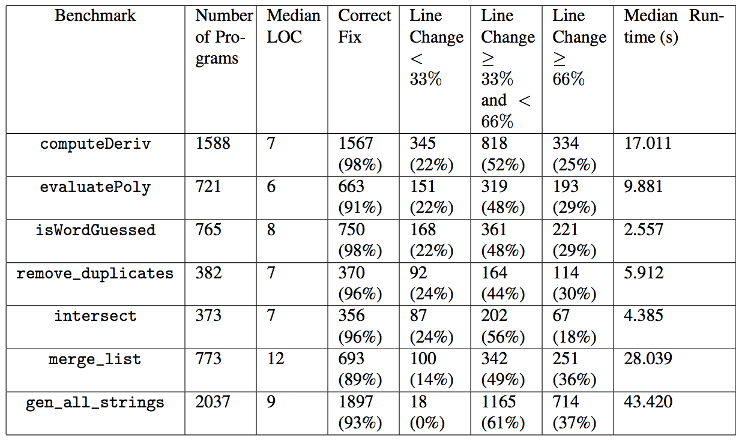
Experiment

Slide 12
Conclusion
Data-driven program repair
  Effective in fixing small incorrect programs
Computer science education
  Same mistakes

