Slide 2





Data Driven Program Completion
Yanxin Lu, Swarat Chaudhuri, Christopher Jermaine, Vijayaraghavan Murali
Presented by Yanxin Lu
Notes:
Introduction
Related work and how related to it
How this is different and better

Slide 3
Programming is difficult
https://docs.google.com/spreadsheet/ccc?key=0Aqe2P9sYhZ2ndElxbjVTcnV2bHFOWmUwSkt2bjZLdVE&usp=drive_web#gid=5

Slide 4
Program Synthesis
Automatically generating programs
Specification
  Logic formula
    x > 0 and y < x
  Unit testing
    f(0, 1) = 0, f(1, 1) = 1, f(2, 1) = 1
  Natural language
    Give me a binary search!
Hard problem!

Slide 5
Related work
Deductive and solver-aided synthesis
  IEEE Trans. Software Eng. 18(8), PLDI 2014
Constraint-based synthesis
  Syntax-guided synthesis, FMCAD 2013
  Sketching, ASPLOS 2006
  Template, STTT 15(5-6)
Inductive synthesis
  Input-output examples, POPL 2011, PLDI 2015

Slide 6




Big data
https://cdn.tutsplus.com/net/uploads/2013/08/github-collab-retina-preview.gif
http://morpheus-ms.sourceforge.net/sourceforge.png
http://cdn.afterdawn.com/v3/news/original/google_code.jpg
http://cdn.sstatic.net/stackoverflow/img/apple-touch-icon@2.png?v=ea71a5211a91&a

Slide 7
Summary
Data-driven program completion
  Demo
  Corpus and Pliny database
  Synthesis algorithm
  Initial experiment and future work
Program repair
Notes:
Previous ones have failed. I will do something better.

Slide 8
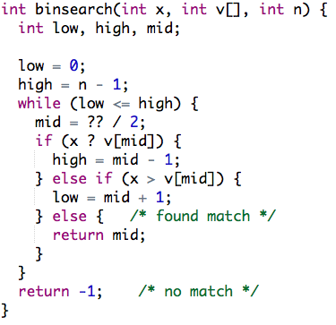
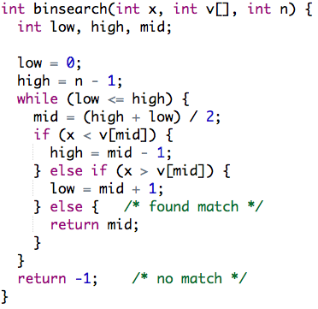
Program Completion
A subset of C
Notes:
Is unit testing an input or is it a separate thing?
Is it test based or logic based?
Where is the unit testing coming from?
What is the input and output?
What can it do and what can it not do?

Slide 9
Demo
Notes:
Variable names in the demo (l, m, h vs low high mid)
No switching back and forth

Slide 10

Architecture
Synthesis
query
Incomplete program
PDB
Top-k similar programs
Completed program
Notes:
PDB – Pliny DB

Slide 11
Architecture
Synthesis
query
Incomplete program
PDB
Top-k similar programs
Completed program
Notes:
PDB – Pliny DB

Slide 12

PDB
Chris Jermaine
Thousands of programs with features
Similarity Metrics
Fast top-k query
  1-2 orders of magnitude faster than no-SQL database systems

Slide 13


Corpus
More than 100,000 projects
Repositories
  GitHub, Sourceforge, Google Code
  C, C++, Java
Preprocessing
  50GB of source code
  480+ projects
  C
Notes:
What is the corpus is used for?
Generating new code?

Slide 14
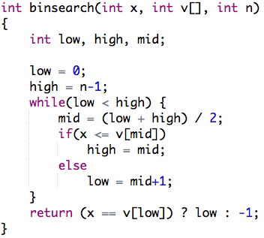
Feature Extraction
Lightweight program analysis
Capturing characteristics of programs
  Abstract Structural Skeleton
    (seq (loop (seq (cond ()))))
  Coupling
('int', 'c:unary-’)
('int', 'c:/’)
('int*', 'c:+’)
('int', 'c:+’)
('int', 'c:-’)
('int', 'c:==’)
PDB

Slide 15
Architecture
Synthesis
query
Incomplete program
PDB
Top-k similar programs
Completed program
Notes:
PDB – Pliny DB

Slide 16
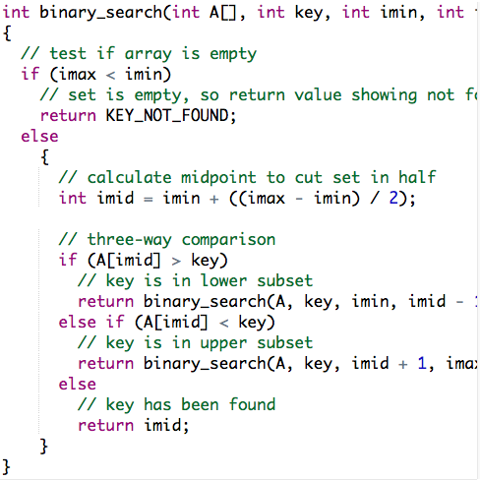
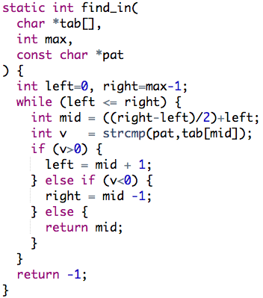
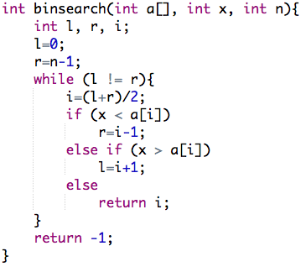
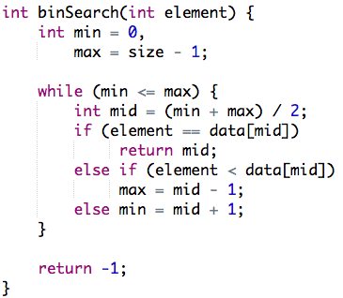
Similar programs
PDB

Slide 17
Filling in the holes
Search for ways to replace holes

Slide 18
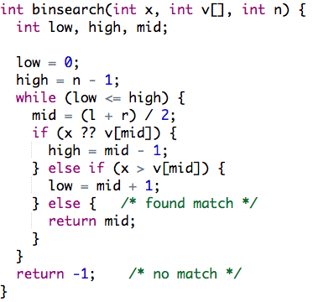
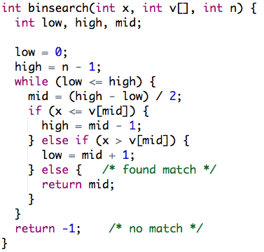
Variable Renaming
Variables not defined
Notes:
Is it just renaming?
Variable alias?

Slide 19
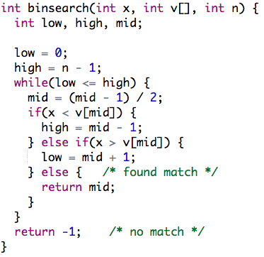
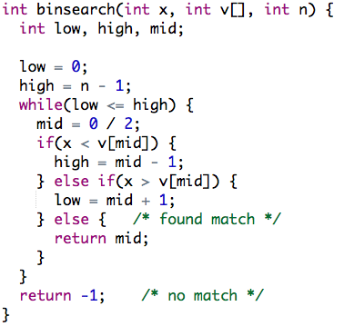
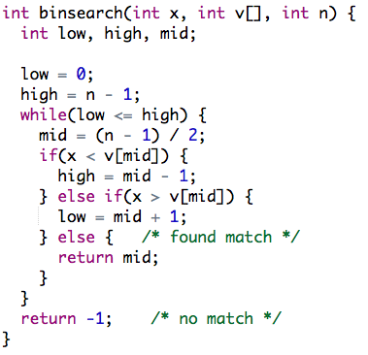
Unit Testing
Filtering out incorrect programs

Slide 20
Heuristics
A set of heuristics
  Types
  Context
Huge search space reduction

Slide 21
Heuristics - types
Ignore expressions with incompatible types
int or double

Slide 22
Heuristics - context
Ignore expressions with no common parents
Binary operation

Slide 23
Initial experiment and future work
Binary search
  Less than 10 seconds
Future work
  More benchmark problems
  Performance increase

Slide 24
Program repair
PDB
As similar as possible
Notes:
How to put holes?
Put a story, or a high level idea.

Slide 25
Bug localization
After bug localization
  Program completion problem
Where to put holes?
  Possible faulty locations
How big is the hole?
  Small holes

Slide 26
Conclusion
Program completion
Program repair
Big data + programming language

