Slide 2





Data Driven Program Completion
Yanxin Lu, Swarat Chaudhuri, Christopher Jermaine, Drew Dehaas, Vineeth Kashyap and David Melski
Presented by Yanxin Lu
Notes:
Introduction
Related work and how related to it
How this is different and better

Slide 3
Programming is difficult
https://docs.google.com/spreadsheet/ccc?key=0Aqe2P9sYhZ2ndElxbjVTcnV2bHFOWmUwSkt2bjZLdVE&usp=drive_web#gid=5

Slide 4
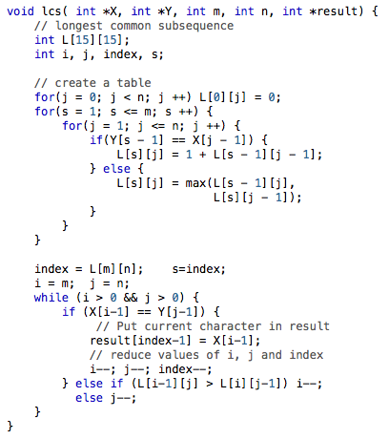
Programming is difficult
Longest Common Subsequence

Slide 5
Program Synthesis
Automatically generating programs
Specification
  Logic formula
    x > 0 and y < x
  Unit testing
    f(0, 1) = 0, f(1, 1) = 1, f(2, 1) = 1
  Natural language
    Give me a binary search!
Hard problem!

Slide 6
Related work
Deductive and solver-aided synthesis
  IEEE Trans. Software Eng. 18(8), PLDI 2014
Constraint-based synthesis
  Syntax-guided synthesis, FMCAD 2013
  Sketching, ASPLOS 2006
  Template, STTT 15(5-6)
Inductive synthesis
  Input-output examples, POPL 2011, PLDI 2015

Slide 7




Big data
https://cdn.tutsplus.com/net/uploads/2013/08/github-collab-retina-preview.gif
http://morpheus-ms.sourceforge.net/sourceforge.png
http://cdn.afterdawn.com/v3/news/original/google_code.jpg
http://cdn.sstatic.net/stackoverflow/img/apple-touch-icon@2.png?v=ea71a5211a91&a

Slide 8
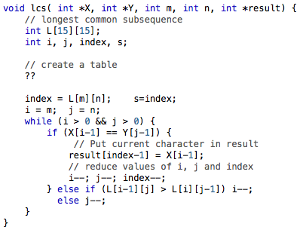
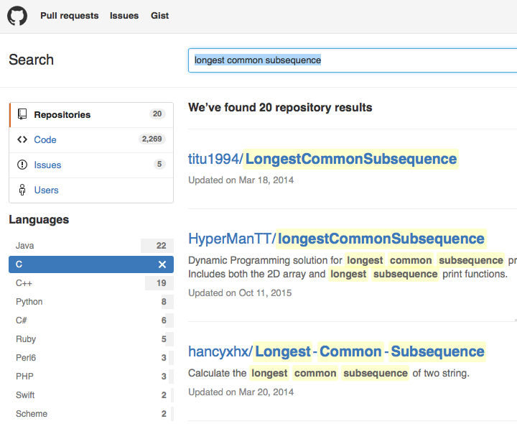
Programming is difficult
Longest Common Subsequence

Slide 9
Summary
Data-driven program completion
  Corpus and Pliny database
  Synthesis algorithm
  Initial experiment and future work
Notes:
Previous ones have failed. I will do something better.

Slide 10
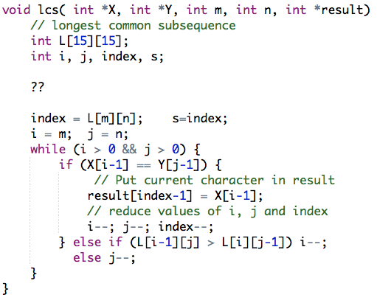
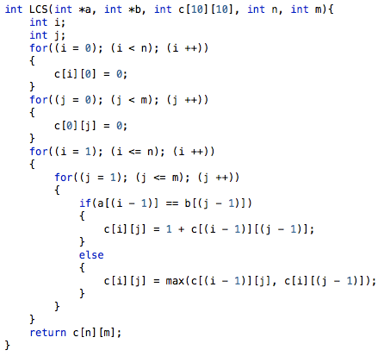
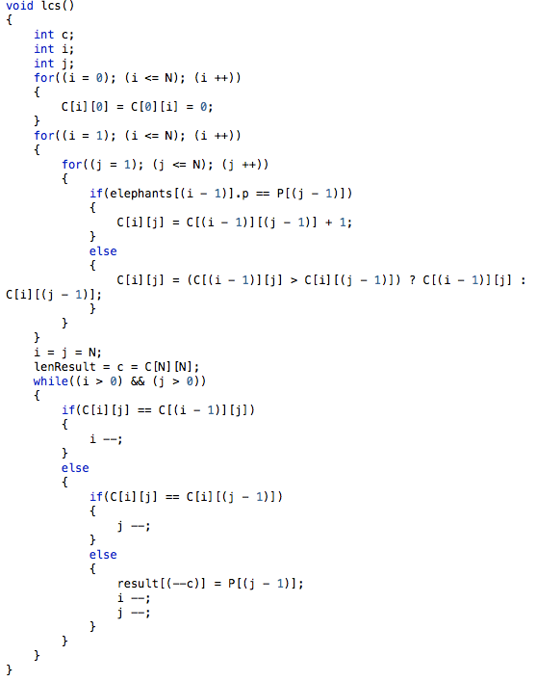
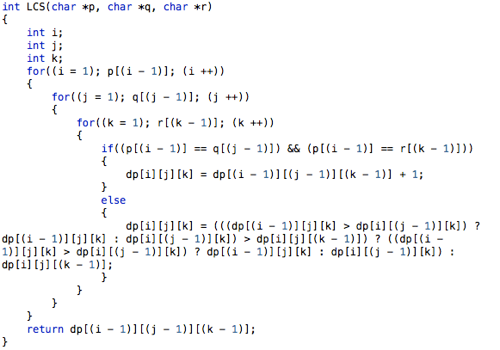
Program completion
Sketch
Progs in DB
LCS(“123”, “123”) should be “123”
LCS(“123”, “234”) should be “23”
Notes:
Is unit testing an input or is it a separate thing?
Is it test based or logic based?
Where is the unit testing coming from?
What is the input and output?
What can it do and what can it not do?
----- Meeting Notes (1/20/16 17:07) -----
1. overview
2. motivating example
3.

Slide 11
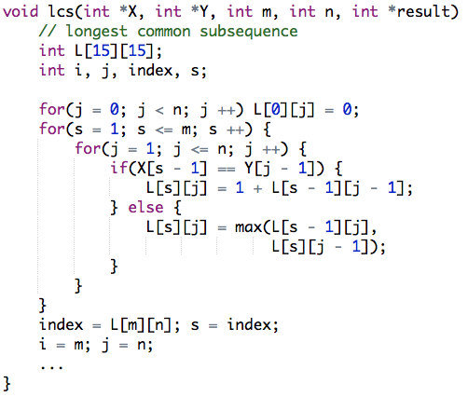
Program Completion
Notes:
Is unit testing an input or is it a separate thing?
Is it test based or logic based?
Where is the unit testing coming from?
What is the input and output?
What can it do and what can it not do?

Slide 12

Workflow
Synthesis
query
Incomplete program
PDB
programs
Completed program
Notes:
PDB – Pliny DB

Slide 13
Workflow
Synthesis
query
Incomplete program
PDB
programs
Completed program
Notes:
PDB – Pliny DB

Slide 14

PDB
Chris Jermaine
Thousands of programs with features
Similarity Metrics
Fast top-k query
  1-2 orders of magnitude faster than no-SQL database systems

Slide 15


Corpus
More than 100,000 projects
Repositories
  GitHub, Sourceforge, Google Code
  C, C++, Java
Preprocessing
  50GB of source code
  480+ projects
  C
Notes:
What is the corpus is used for?
Generating new code?

Slide 16
Feature Extraction
Lightweight program analysis
Capturing characteristics of programs
  Names
    X, s, n, j, Y, index, lcs
  TF/IDF
“charact” : 0.158
“reduc” : 0.158
“result” : 0.316
“lc” : 0.791
“index” : 0.316
PDB

Slide 17
Architecture
Synthesis
query
Incomplete program
PDB
programs
Completed program
Notes:
PDB – Pliny DB

Slide 18
Search for programs
PDB

Slide 19
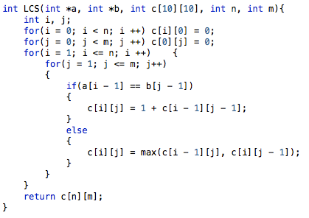
Filling in the holes
Search for ways to replace holes

Slide 20
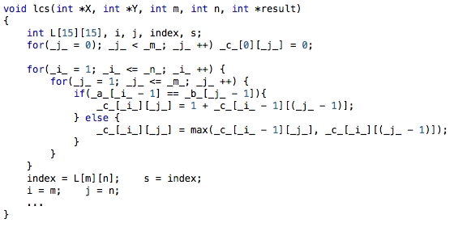
Merging
Undefined variables
Notes:
Is it just renaming?
Variable alias?

Slide 21
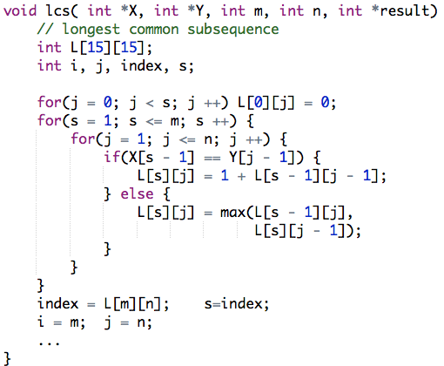
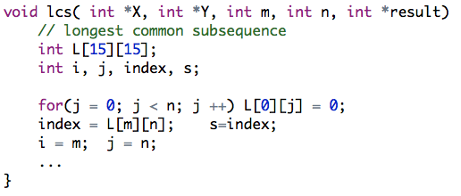
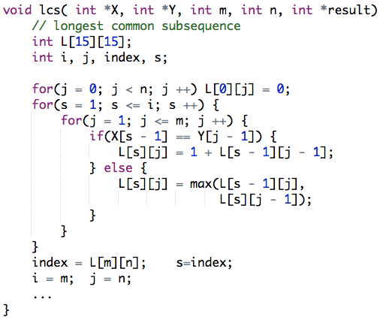
Testing
Filtering out incorrect programs

Slide 22
Heuristics
Some heuristics
  Types
  Context
Huge search space reduction

Slide 23
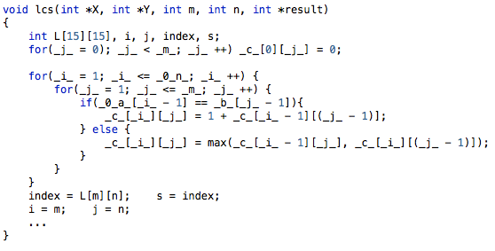
Heuristics - types
Ignore variables with incompatible types

Slide 24
Heuristics - context
Ignore expressions with no common parents

Slide 25
Initial experiment and future work
LCS
  Less than 10 seconds
Future work
  More benchmark problems
  Performance increase

Slide 26
Initial experiment and future work
Benchmark | Runtime (sec) | # PDB programs | Sketch LOC | Completed LOC | # incorrect | # holes
Primality Testing | 1.1 | 3 | 8 | 18 | 17 | 1
LCS | 5.6 | 3 | 34 | 51 | 692 | 1
Dijkstra (train) | 13.3 | 3 | 53 | 61 | 2152 | 1
Clustering | > 300 | 1 | 34 | 48 | 207803 | 2
Future work
  More benchmark problems
  Closure
  Search PDB using types

Slide 27
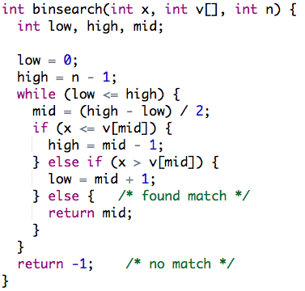
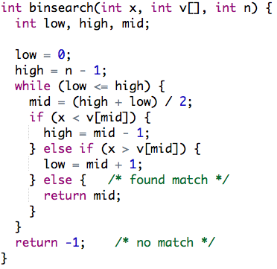
Program repair
PDB
As similar as possible
Notes:
How to put holes?
Put a story, or a high level idea.

Slide 28
Bug localization
After bug localization
  Program completion problem
Where to put holes?
  Possible faulty locations
How big is the hole?
  Small holes

Slide 29
Program Completion
No more copy and paste
Focus on important tasks

